Slide 1


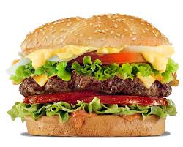

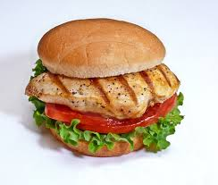


    Four Seasons Invites you to the End of Season Banquet.
    When: July 26, 2015
    Where: Four Seasons’ Pool
    Who’s Invited: Swimmers, their families and friends
    RSVP: RSVP via the link on the calendar
    Cost:
          Swimmers – No Charge
          Family / Friend Tickets - $10 / person Prior to July 22nd
          At Door (after July 22nd) - $15 / person
    Catered by Jimmy’s Tavern, Four Seasons’ GOLD sponsor.
Jimmy’s Tavern 697 Spring St. Herndon, VA 20170 703-435-JIMS

