Slide 1
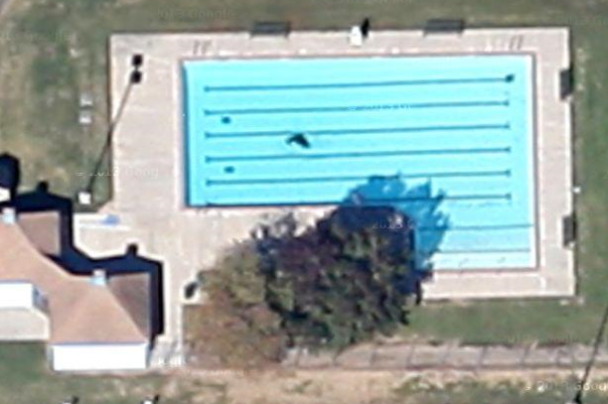
Jerry Matheson Park Pool
1240 Ulrich Rd, Tomball, TX 77375
6 ft deep , deep end of pool
Deep End Slide , between two lanes
Computer Room @ Pool Office
Restroom for officials Only & Computer
Covered Seating Ready Bench

Slide 2
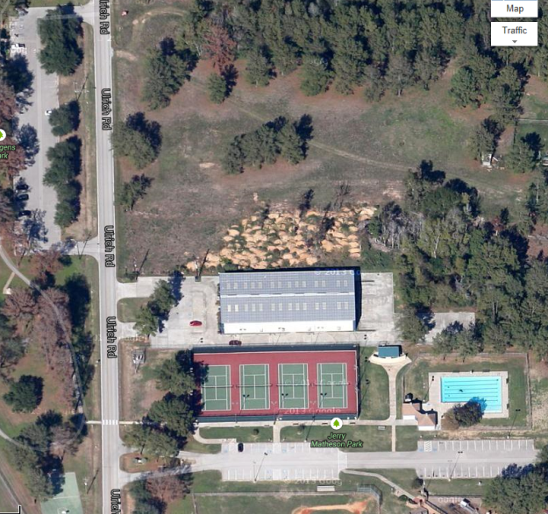
Parking ( First Come , First Served )
Juergen’s Park Parking ( Walking Distance 80 Spaces )
This field would be fine too.
Back of Gym Only/ Side too( Walking Distance 80 Spaces )
Jerry Matheson Parking 60 spaces

Slide 3
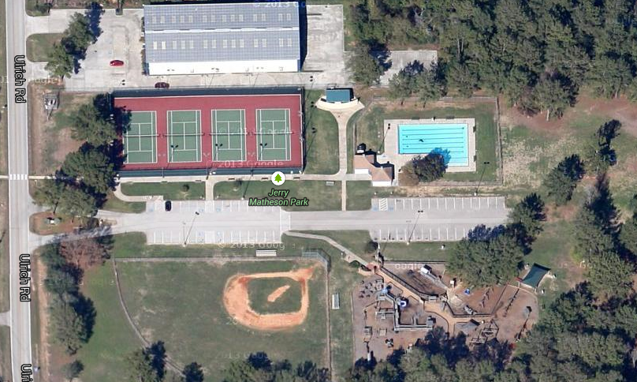
Team Areas & General Information
Dual Meets
Public Restrooms
Home Team
First Aid Station
Visiting Team
DJ & Concessions Stand
Ready Bench

