Slide 1
How to Prepare for a Swim Meet
Three Parts:
1. Preparation the day before 2. Preparation on the day 3. Swimming
Swim meets test swimmers' strength, technique, and concentration in a highly competitive environment. To do your best at a swim meet, it's important to ensure that you're well-rested, yet alert and full of energy when your meet starts. Doing this requires planning and effort on your part, but it's worth it - being in tip-top shape at your meet can make the difference between a good performance and a great one!

Slide 2
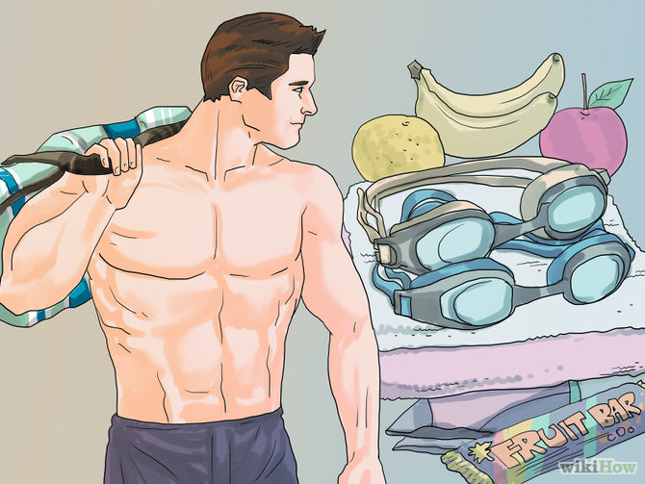
Part 1 of 3: Preparation the day before
1
Pack a bag of things you need for the meet. This helps because you won't be scrambling the next morning gathering your things and you can get as much rest as possible. Pack things such as towels, two pairs of goggles, two swim caps, fruit, nuts, water, and an energy beverage that contains electrolytes to resupply the loss minerals.

Slide 3
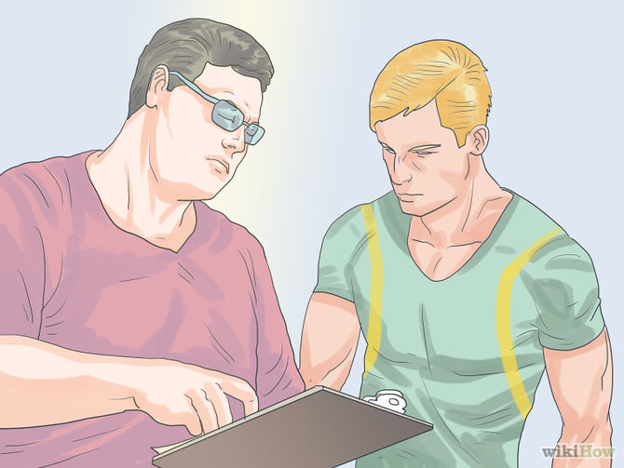
2
Make sure that you know your game plan for the meet the next day.
For example; ask your coach what time warm ups are, what events your swimming, and whether or not the meet has positive check in. (Positive check-in is when you have to write your initials next to your name on a sign in sheet. This lets the officials know that you are there and so they write out the heats so that there are no empty lanes.)

Slide 4
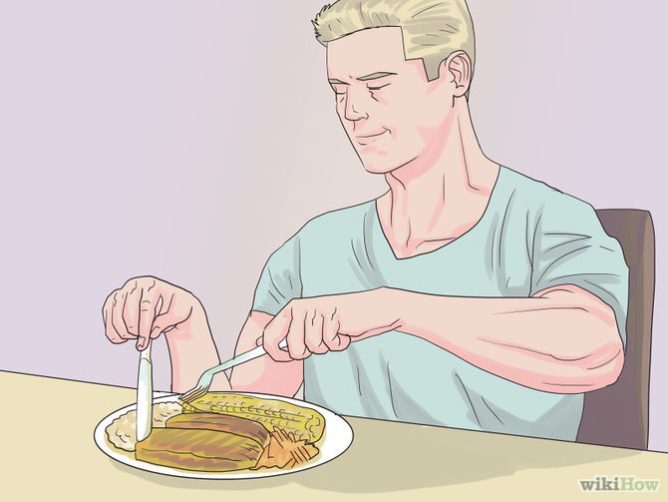
3
Eat a good dinner the night before you swim. Eat plenty of carbohydrates and proteins but don't eat something to heavy or completely out of the norm. Stay away from acidic foods (including tomato and tomato sauce) for they will upset your stomach and cause cramps. The best plan is to eat something simple, easy to digest. Although pizza, chicken wings, and plates of pasta may seem like "Power food," the reality is that they will sink you like a rock. Carb loading is a technique that is out dated and since been proved inefficient and unhelpful unless in special circumstances only usually encountered at an elite level.

Slide 5
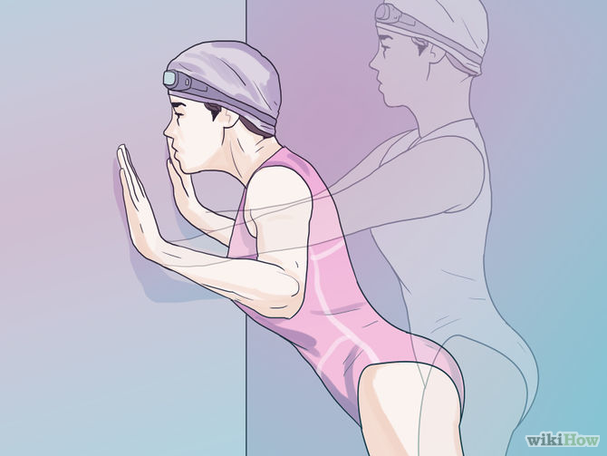
4
Do your best to ensure you are not sore or stiff the next day during your swim meet. If it is a multi day swim meet, warm down after every event. If a warm down pool is unavailable, conditioning exercises such as jogging, jumping jacks, and wall push ups then follow with static or dynamic stretches.

Slide 6
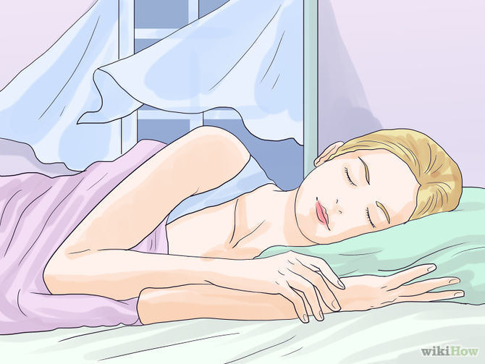
5
Go to bed as early as possible beginning days before your swim meet, especially if you are getting up early. If you go to bed at midnight every night for a week and get 5 hours of sleep every night for a week, getting 10 hours of sleep the night before is not going to help you. You will still be exhausted the day of the swim meet.

Slide 7
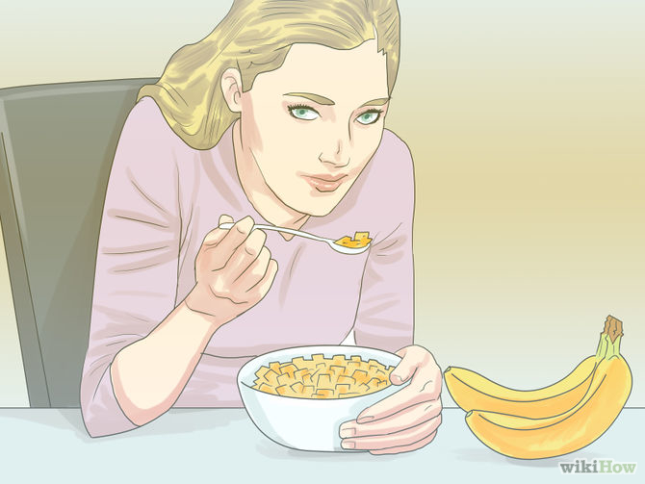
Part 2 of 3: Preparation on the day
1
Eat a light breakfast such as a bowl of cereal and a banana, or an energy bar if you're swimming a morning event. If you're swimming in the afternoon, eat a big breakfast and a light lunch. Eat one or two hours before the event. Bananas, crackers, and plain toast with no butter in modest amounts are good food. The best foods are pasta, cereals, bagels, breads, fruits, and vegetables. These are out of the stomach in two hours, therefore should not be eaten more than three hours before swimming or they could override the energy in time for the race. Bananas are great because they have potassium which makes you more resistant to fatigue. Remember, no sugar.

Slide 8
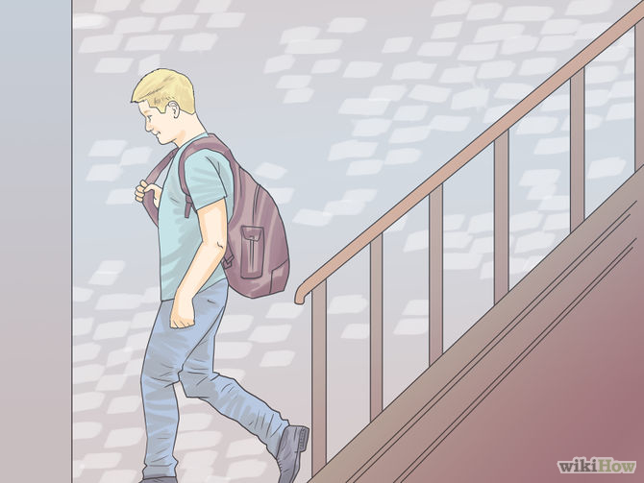
2
Rest. If you have school, do not rush between classes. Take your time walking up and down the stairs. Do not over-exert yourself, save your energy for the race.

Slide 9
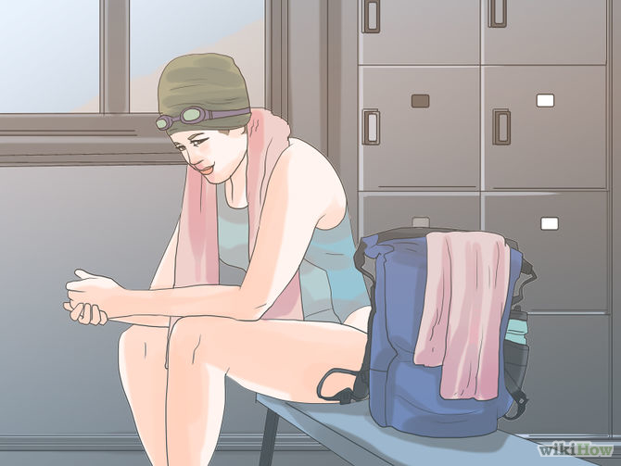
3
Put on your bathing suit right before you leave and gather your stuff for the meet. Don't put Fastskins on until after warm up and you are dry. Be sure you have water and healthy snacks. If you are swimming both trials and finals, you are going to need up to five towels; however, you can hang up your towels to dry to save space in your bag.

Slide 10
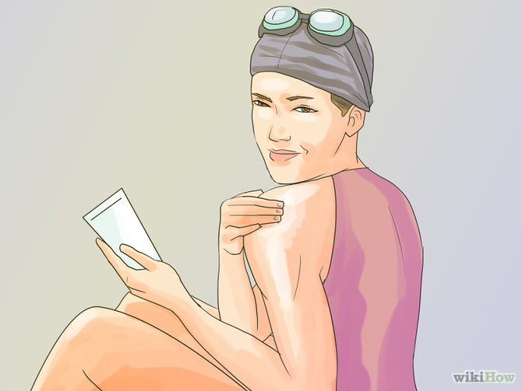
4
Put on sunscreen if outside. Remember, put it on after coaches register you first, it takes 30 minutes to soak in. You don't want goggle tans, that's for certain.

Slide 11
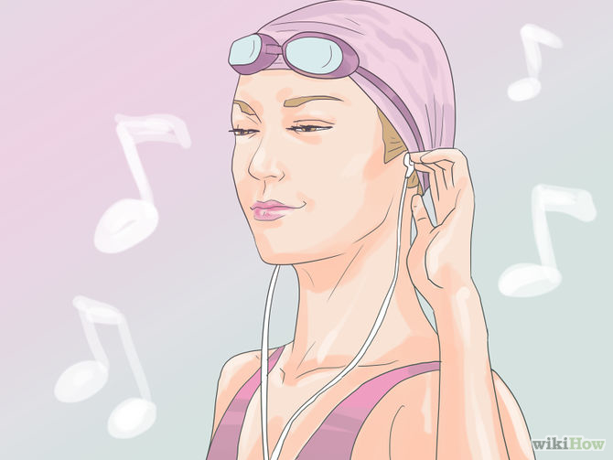
5
Listen to some good pump up music. Plug in your iPod or phone and listen to your favorite mix of tunes. Dance if want but don't wear yourself out.

Slide 12
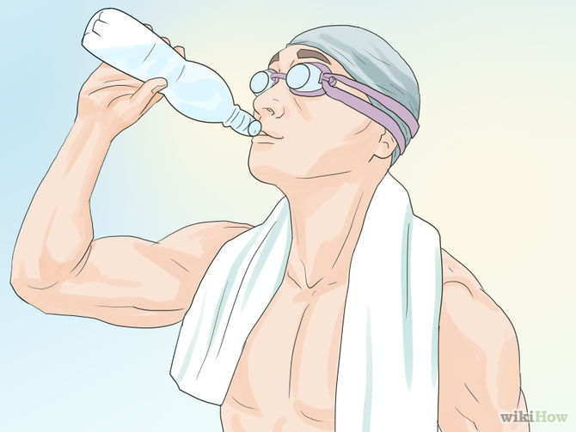
6
Drink plenty of liquids. Electrolyte drinks and water are the best liquids. Many people think that Gatorade is good but it is high in sugar (but can still help). Only drink this five minutes before an event. Drink plenty throughout the day and during the meet. Lack of liquids do affect your performance as well, even before you feel thirsty.

Slide 13
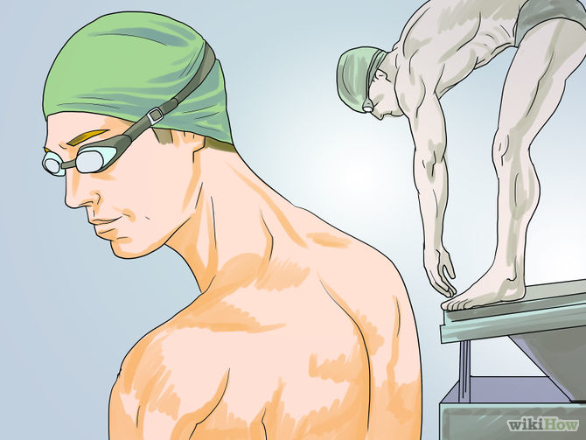
Part 3 of 3: Swimming
1
Focus on the things that you can control vs. the things you can not control. 'You can control your start and your turn, you can not control the size or speed of your opponent. You can control what you eat before your race, you can not control the traffic on the way to the meet.

Slide 14
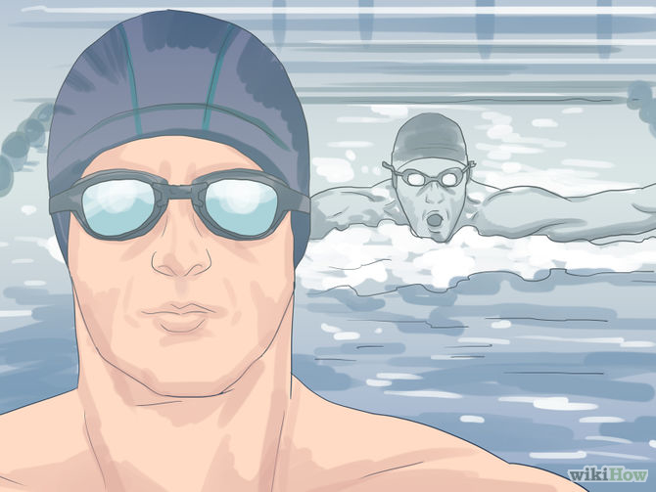
2
Visualize your race. Sit down somewhere quiet, and visualize the race from the moment you're up on the block to the moment you hit the wall. Visualize the exact time that you want to see on the time board. This helps keep a positive attitude.

Slide 15
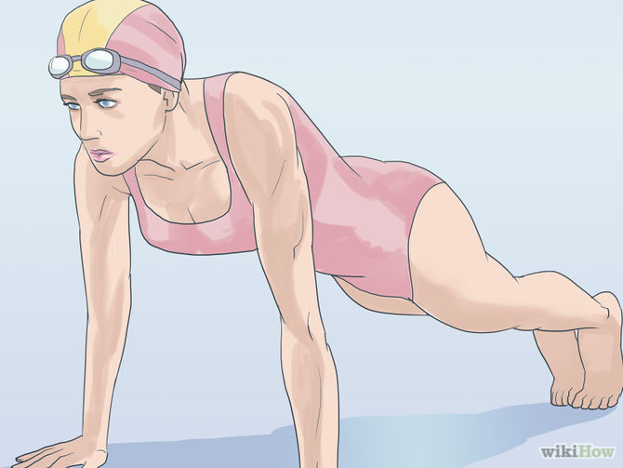
3
Get in the zone. Depending on what kind of person you are, you may want to get pumped. Do a super intense, but quick pre-race for 30 seconds of push-ups, jumping jacks, or anything's that suits you to get you going, 10 minutes before your race.

Slide 16
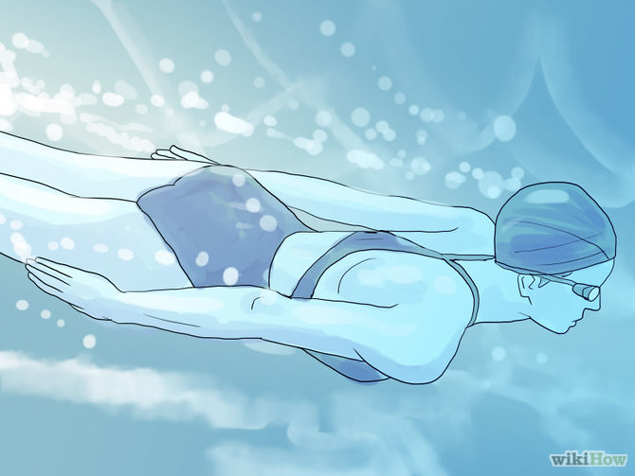
4
Get in the pool and swim. Don't tire yourself out, or go too fast. Get in and stretch out and get a feel for the water. Drills are great for this.If you do feel the need to go fast, do a short hard set but don't go over 80 percent of your maximum speed. Make sure your intervals give you a good amount of rest. This will get the blood flowing, you will get a feel for your stroke, and you will remain rested for your big meet. The point is you need to conserve your energy while keeping your body conditioned at the same time.

Slide 17
Tips
1. Just relax, don't stress out over anything, and enjoy yourself, meets are a good opportunity to bond with friends and make new ones.
2. Don't get too nervous. It may affect your performance.
3. Don't stress yourself in practice if it is the day before.
4. It's a good idea to elevate your feet for about an hour while you're resting. Lay on your back and put your feet up on a chair. Breathe slowly and deeply. Now is a good time to do visualization of your race strategies or relaxation exercises.
5. Write down your races so you don't miss any.
6. Get to the meet early to avoid stress.
7. Remember to always keep your goggles and cap near at all times, and watch the board so you can be prepared for your event.
8. You should always stretch before your meet; stretch for about 20 minutes at home, doing arm swings, and stretching those quads, especially for breaststrokers.
9. Never think you are going to lose. It will slow you down a bit.
10. If you have a kid swimming (your child) write all of their event/heat/lane numbers on there arm so they don't forget. Most likely, older kids will notice this and help them get to their race on time.

Slide 18
11. Parents, you may be reluctant to allow your young child to hang out with an other children during the swim meet instead of you. Sorry to burst your bubble, but that's selfish. Your taking up room in the 'team area when you could be volunteering. Unless your child can not function without your help, get out of the way and let the coaches/other swimmers take care of your kid. They were all once young swimmers too and they know the drill.
12. Keep yourself warm when not swimming. Wear your favorite sweatpants and comfiest sweatshirt. Over 80% of your blood is in your abdomen area (stomach, chest) so make sure that that part is always cover, wet towels do not count.
13. Especially during the summer, you need a ton of water. Four to six water bottles should get you through the meet.
14. Stick to one bottle of Gatorade, about a sip before/after races. Too much Gatorade will get you sugar high, which will just let you down right when you need the energy. 'Dehydration takes two weeks to fully recover from, don't risk it!!
15. Its hard to race if you have to pee. Take care of that before hand.
16. While you are preparing to swim, a couple minutes before your race, increase your blood flow by jumping, shaking you arms, etc.
17. Always ask your coach for advice before you swim. They know best and can always give you some tips.
18. Although sugar is supposed to make you hyper, it won't. If you have the need for something sweet, a small helping will do the trick.
19. Eat a little bit each time after you race. This will prevent the urge to over eat after your meet. Over eating after your meet will damage your performance the following day.

Slide 19
SMART EATING FOR SWIMMERS ON RACE DAY
Everybody has a different approach when it comes to eating on race day. Having a strategy and an execution plan can remove doubt and worry about hunger, energy levels, digestive problems, and keep you focused on the race at hand.
Here are a few guidelines for smart eating and packing up the cooler:
Don’t DQ your day. Breakfast at home or on the road is the metabolism boost every swimmer needs. Instant oatmeal made with skim or low fat milk, toast with nut butter, dry cereal, yogurt and fruit are all light options that rev up the body. If you are competing in the morning, be sure to keep it light. Opt for a heavier breakfast if competition is in the afternoon.
Pack variety. A few options of fruit, vegetables, grain and high quality protein sources should cover the variable appetite and tummy tolerance you may experience on race day. It’s better to have more food options than a large quantity of only two or three foods. Don’t make the mistake of relying on a single food or energy bars to get you through the day. While they can do the job of fueling your body, they may not rate in appetite satisfaction. Having a variety of food sources increases the odds of proper fueling and healthy eating.
Pack enough. You don’t want to run out of food, and you may want to share with other swimmers (well-fueled swimmers help the whole team, right?).
Pay attention to temperature. If you are packing perishables, be sure to add an ice pack. It’s no fun to get tummy cramps before a race because something has spoiled.
Pack in the protein. Protein will be an ally in keeping your blood sugar stable, thus keeping hunger, energy and mood in check. Nibble on cheese sticks or slices, nuts, peanut or nut butters, deli meat slices, yogurt or yogurt drinks, boxes of low fat milk, hummus, hard-boiled eggs.

Slide 20
Don’t forget the Carbohydrate. Your muscles rely on carbs for fuel. Pack easily digestible sources such as 100% juice, fruit leather, applesauce, fresh or dried fruit, or veggie sticks. Don’t forget the more complex carbohydrate foods too, such as crackers, unsweetened dry cereal, pita or other breads, pretzels and graham crackers. Stay away from refined sugars such as soda, candy and desserts on race day.
Nosh or Nibble? Save “meals” or large quantities of food for big breaks between events. Nibble small amounts of food before and after events that are closely scheduled. At a minimum, you should be nibbling to stay energized and keep your muscles fueled on race day.
Think your drink. Water, 100% fruit juice and sports drinks are appropriate at a swim meet. Plain and flavored milk are great recovery drink choices after the meet; they provide protein for muscle repair and carbohydrate to re-fuel muscles.
Know your eating style on race day. If it is counter-productive to racing, follow these guidelines as a strategy for optimal eating. Don’t tempt yourself by packing foods or making concession purchases that you (really) don’t want to be eating.
Fiber Facts. Fiber can be a problem on race day, or not. Fiber is a food component to which each swimmer has an individual tolerance. Don’t experiment with high fiber foods on race day; sort this out during training season and avoid tummy trouble when it matters most.

Slide 21
NUTRITION FOR SWIM MEETS
Swimmers should focus on eating balanced and nutritious foods all of the time. This article will give you some guidelines to following when eating before, during, and after the meet. Eating at swim meets is difficult, the timing and run around at a meet makes it tough, but you must try to eat a healthy breakfast, lunch and dinner even while you are constantly on the go. In order to ensure that your body has the right levels of fuel, you need to plan in advance what and when you will eat during the meet.
BEFORE THE MEET
Swimmers should not rely on the pre-meet meal to supply the energy for the meet, as the energy that will be used during the races should already be stored in the muscles from nutrient-rich meals eaten during the previous two to three days. However, the swimmer should not skip the pre-meet meal even if there is every early start to the meet.
GOOD EATS BEFORE THE MEET
• Cereal --- Toast
• Bagel ---- Pancakes
• Juice ---- Fruit
• Protein Bar
Ideally the pre-meet meal should be eaten 2-4 hours before the first race to allow the food to be digested and leave the stomach. If there is still food in the stomach when it comes time to race, oxygen-rich blood will be going to the stomach to aid digestion instead of the muscles where it is needed. The meal should be about 500-1000 calories and should be high in complex carbohydrates and low in fat and protein. The most important thing to remember about the pre-race meal is to eat--and eat mostly carbohydrates. AVOID processed sugars and “Energy” drinks.

Slide 22
DURING THE MEET
The most important thing to remember when eating during the meet is to drink plenty of fluids and eat small amounts of carbohydrate-rich foods. If you have less then an hour between events, stick to water, diluted sports drinks and fruit juices, part of a high carbohydrate energy bar, fruit or a few lo-fat crackers.
If you have 2-4 hours between events you can eat something more substantial such as a bagel, toast, fruit and granola bars, or dry cereal. Avoid anything that has too much fat, fiber, or protein as these nutrients slow down digestion. Remember, that if here is food in your stomach there is blood aiding in digestion that could be supplying the muscles with oxygen.
EATS DURING THE MEET
• Cup–o–soup
• Dry Cereal
• Fruit & Fruit Juices (Diluted)
• Fruit Smoothies (Small and avid sugar filled)
• Breads – bagels - muffins
• Oatmeal in a cup • Pretzels
• Sandwiches of turkey or other low-fat meat
• Trail Mix
• Vegetables
• Jerky
• Yogurt

Slide 23
Do not rely on concession stands at swim meets to provide you with food during the meet. They often do not provide very nutritious selections. Stay away from the pizza, nachos, hot dogs, and candy and go for the bagels, vegetables, water, and fruit. Never rely on the concession stand to provide healthy choices; always plan ahead and pack nutritious foods that you are familiar with. Meet days are not times to try something new. AVOID processed sugars and “Energy” drinks.
RECOVERY NUTRITION AT THE MEET
Recovery nutrition is about planning an eating and drinking strategy that helps your body:
1. Recover from the physical stresses of racing
2. Prepare for the racing to come
This is also called the REPAIR – PREPARE approach to Swim Meet eating. 2 Recovery nutrition is a technique which provides the swimmer’s body with what they need to recover … e.g. carbohydrates to replace used up energy, proteins for muscle building and repair … and prepare for the next day of competition. In between races, recovery nutrition is about replenishing energy stores quickly and effectively so that the next race can be completed at maximum speed.

Slide 24
FOODS THAT AID IN A RECOVERY NUTRITION PROGRAM BETWEEN RACES INCLUDE
• Fruit
• Fruit Smoothies
• Dried Fruits
• Sports Drinks
• Chocolate Milk
To maximize the impact of these “recovery foods” they need to be eaten or drunk as soon as possible after racing in small amount! Do not fill yourself up!
AFTER THE MEET
To speed up recovery after meets, be sure to drink 16 to 24 ounces of fluids such as water or diluted sports drink or fruit juice before your last race. Also, within a half hour after your last race eat a high-carbohydrate snack with some protein. This will aid in your recovery. Then within two hours of the end of the meet, eat a full balanced meal.
• Spaghetti with Meat Sauce
• Bean Burritos with rice
• Low-fat beef or chicken with potatoes or rice
• Milk
• Yogurt
• Fruit & Vegetables
• Chocolate Milk

Slide 25
SCHEDULE WHAT TO EAT WHEN TO EAT (RECAP)
• Early Morning Heats (8am-10am)
• Eat breakfast between 6am-7am– light meal, complex carbohydrates
• Cereal
• Toast
• Bagel
• Juice
• Fruit
• Fruit Smoothie
• Afternoon Heats/Semi-Finals/Finals (2pm-4pm)
• Eat between 11am-1pm depending on start time – allow approx 2 hours
• Pasta Salad
• Cup of noodles
• Small sandwich
• Salad • Rice
• Evening Events (6pm-9pm)
• Eat between 4 pm - 5 pm meal (early dinner) – small quantities
• Spaghetti with Meat Sauce
• Bean Burritos with rice
• Low-fat beef or chicken with potatoes or rice • Milk
• Yogurt • Fruit
• Vegetables
• Breads
• Rice

