Slide 1

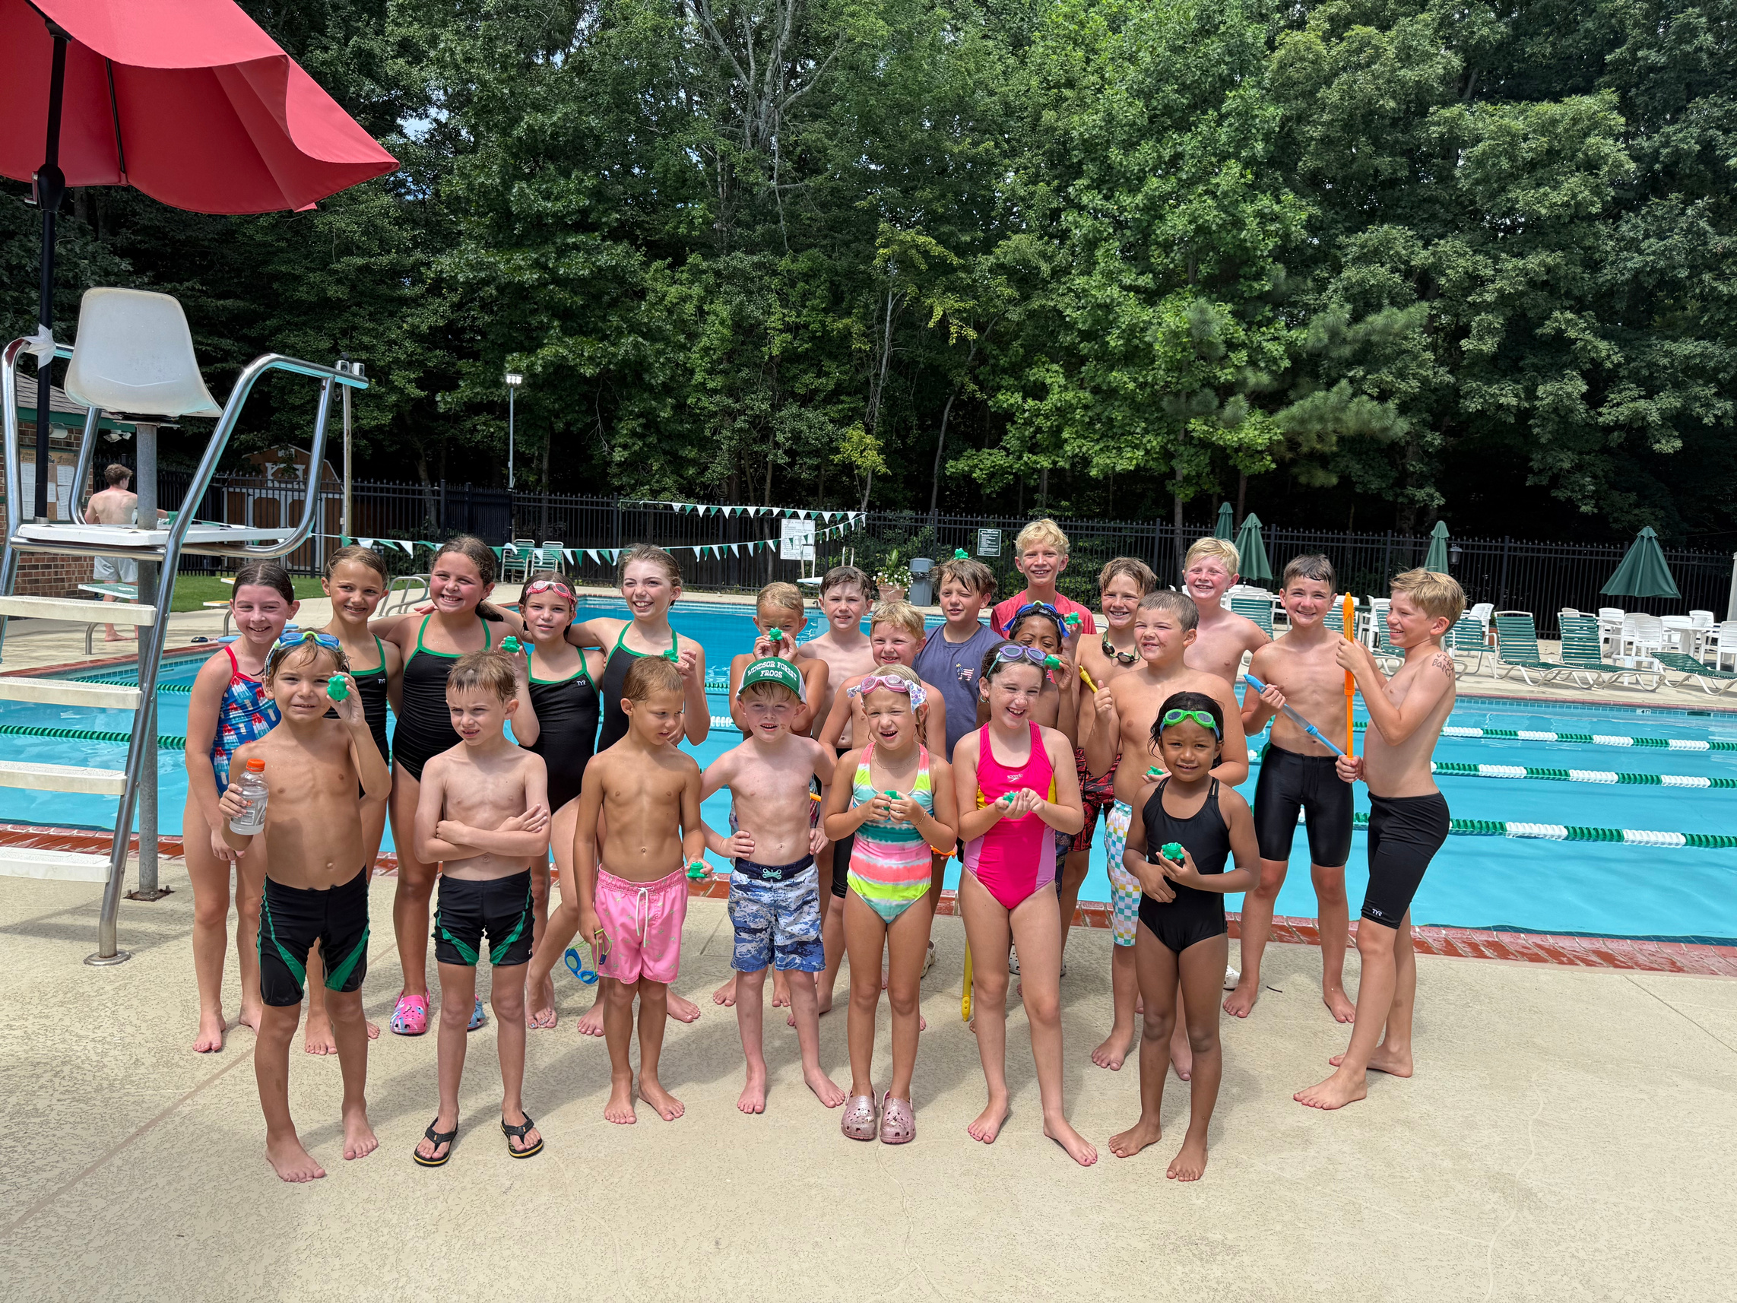
Treasurer: Amber Spicer
Head Referee: Richard Long
Welcome to
WINDSOR FOREST
SUMMER SWIM
2026 SEASONS
Head Coach: Mandy Gorelick
Assistant: Aiden Butler
Assistant: Anson Butler
Head Tadpole Coach: Amelia Butler
Assistant Tadpole Coach: Anson Butler

Slide 2

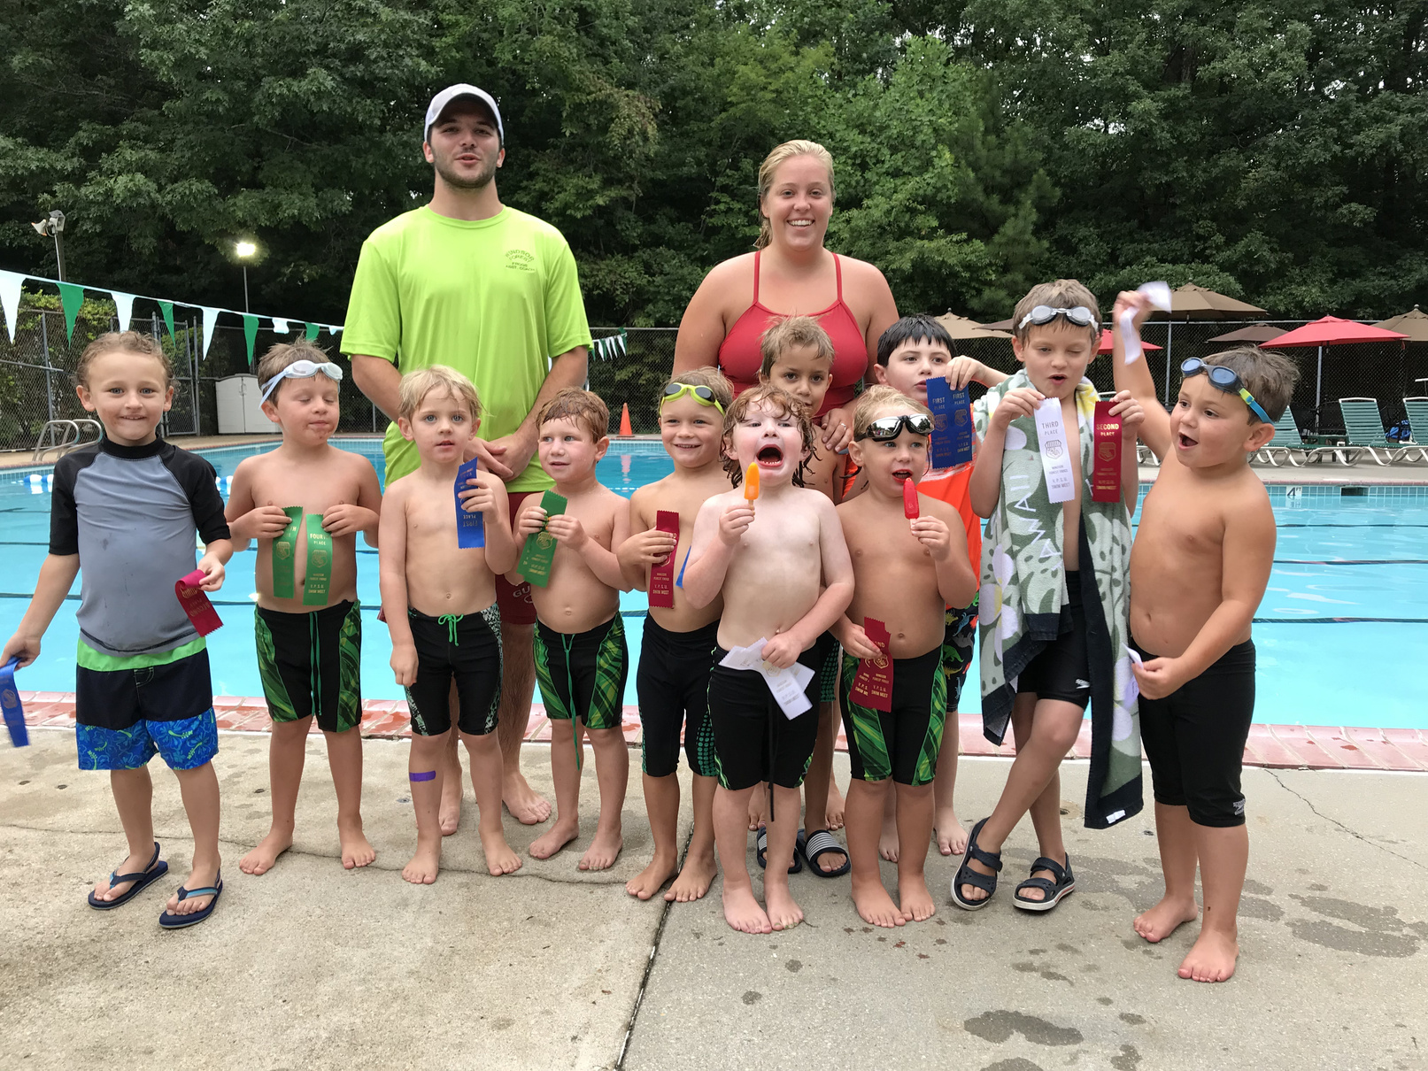

WELCOME TO OUR
FROG SWIM TEAM FAMILY
SUMMER 2026
Windsor Forest Swim Team
Winsdor Forest Frogs swim team has been around since the early 1970's. It has been the driving force throughout our community for children of all ages as well as families to develop lasting friendships and a love for the sport of swimming.

Slide 3
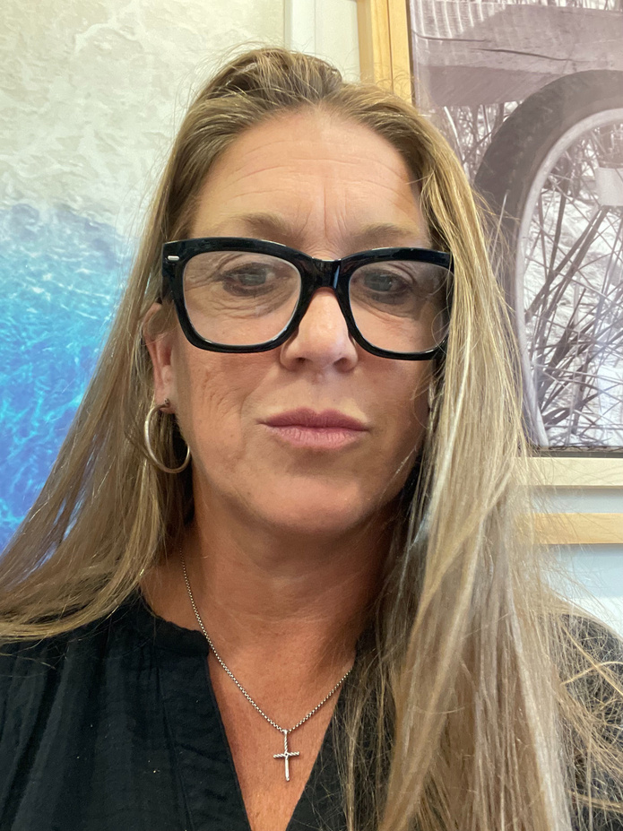
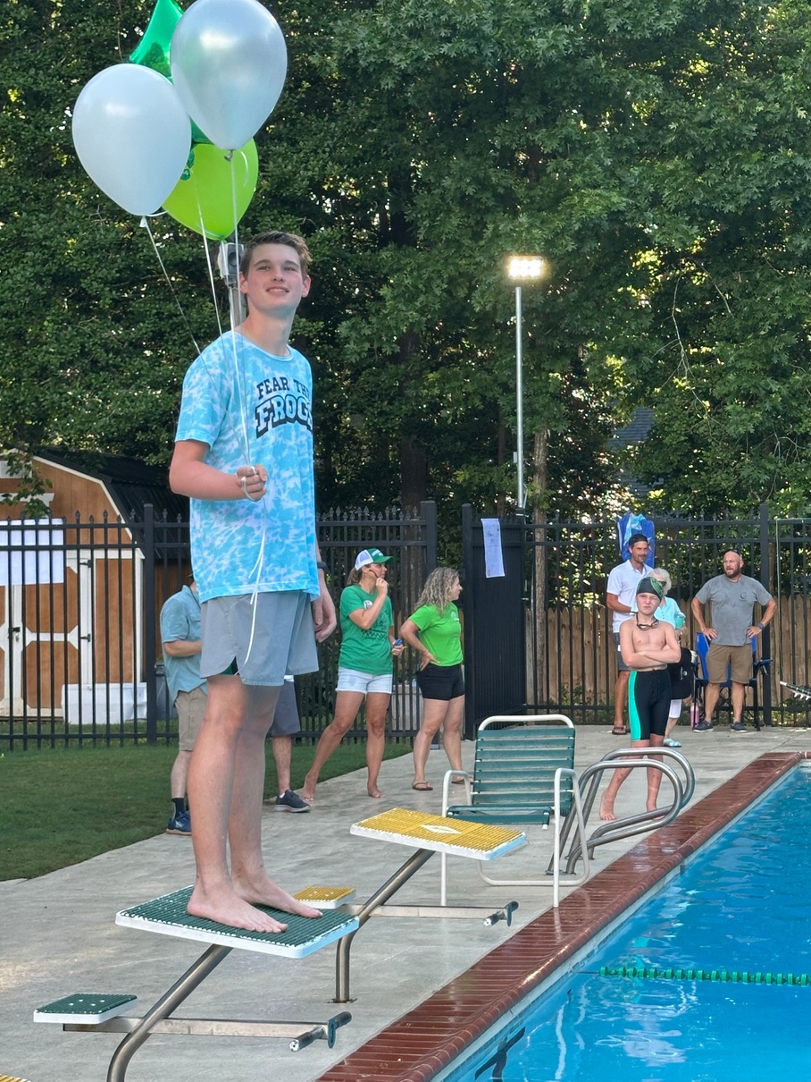
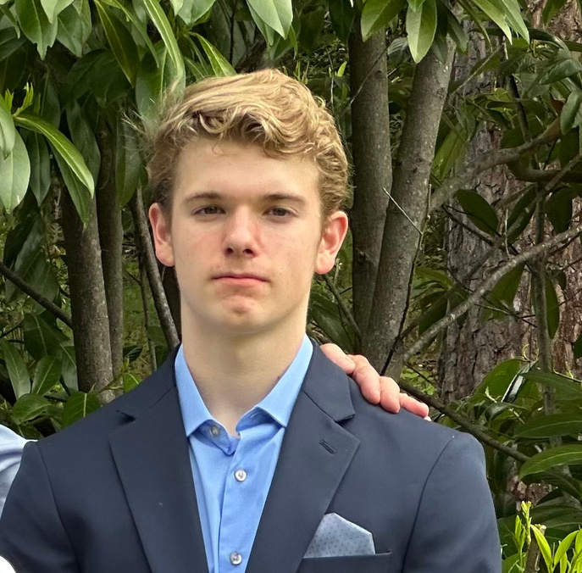
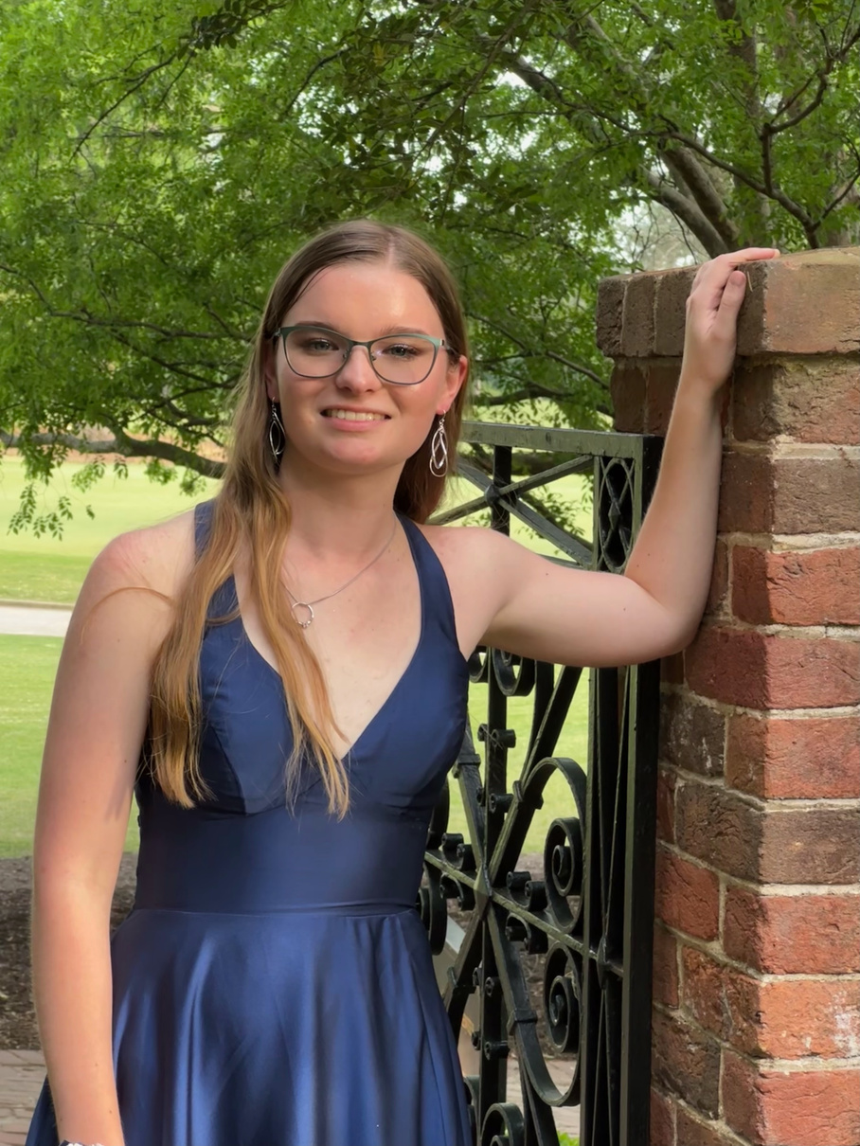
MEET OUR COACHES
Head Coach
Mandy Gorelick has been the Head Coach for Windsor Forest Swim team for the last 10 years. Mandy started her swimming career as a Frog 45 years ago and finshed as a swimming for the University of Tennessee. Mandy has over 30+ years of experience coaching all levels of swimming including Summer league, Highschool as well as USA Swimming.
AIDEN BUTLER
ANSON BUTLER
AMELIA BUTLER
Assitant Coach
Began swimming career as a frog at age 5 and now swims for his club team at Univ. of Tenn. Aiden is our strategic expert! This will be Aiden’s 3rd year coaching with the Frogs
Assistant Coach & Tadpole Coach
Began frog career at the age of 5 and started swimming year round in 6th grade. Anson has grown from summer league to setting his sights on D1 swimming
Head Tadpole Coach
Has been a swimming for the frogs for 14 years. This being her 4th year coaching with the frogs

Slide 4

SWIM TEAM PRACTICE EXPECTATIONS
  Swimmers are expected to be at practice Mon-Fri unless they have another activity or appointment already scheduled. Swimming is a difficult sport, without practice it is hard to improve!
1. Swimmers should be on time
2. Bring water bottle, goggles and hair tie/cap if necessary
3. Come to practice to develop into a swimmer not to complain
or impede others from becoming better swimmers.
4. Have FUN and make new friends!!
  Fun Day; Every Tuesday after the meet practice times are slightly different. Coaches will reveiw of the meet, pass out ribbions, donuts and free time
1st practice 9:00-9:55. 12 and up
2nd practice 10:00--10:55. 9-11 years old
3rd practice 11:00- 11:30 8 & Under

Slide 5
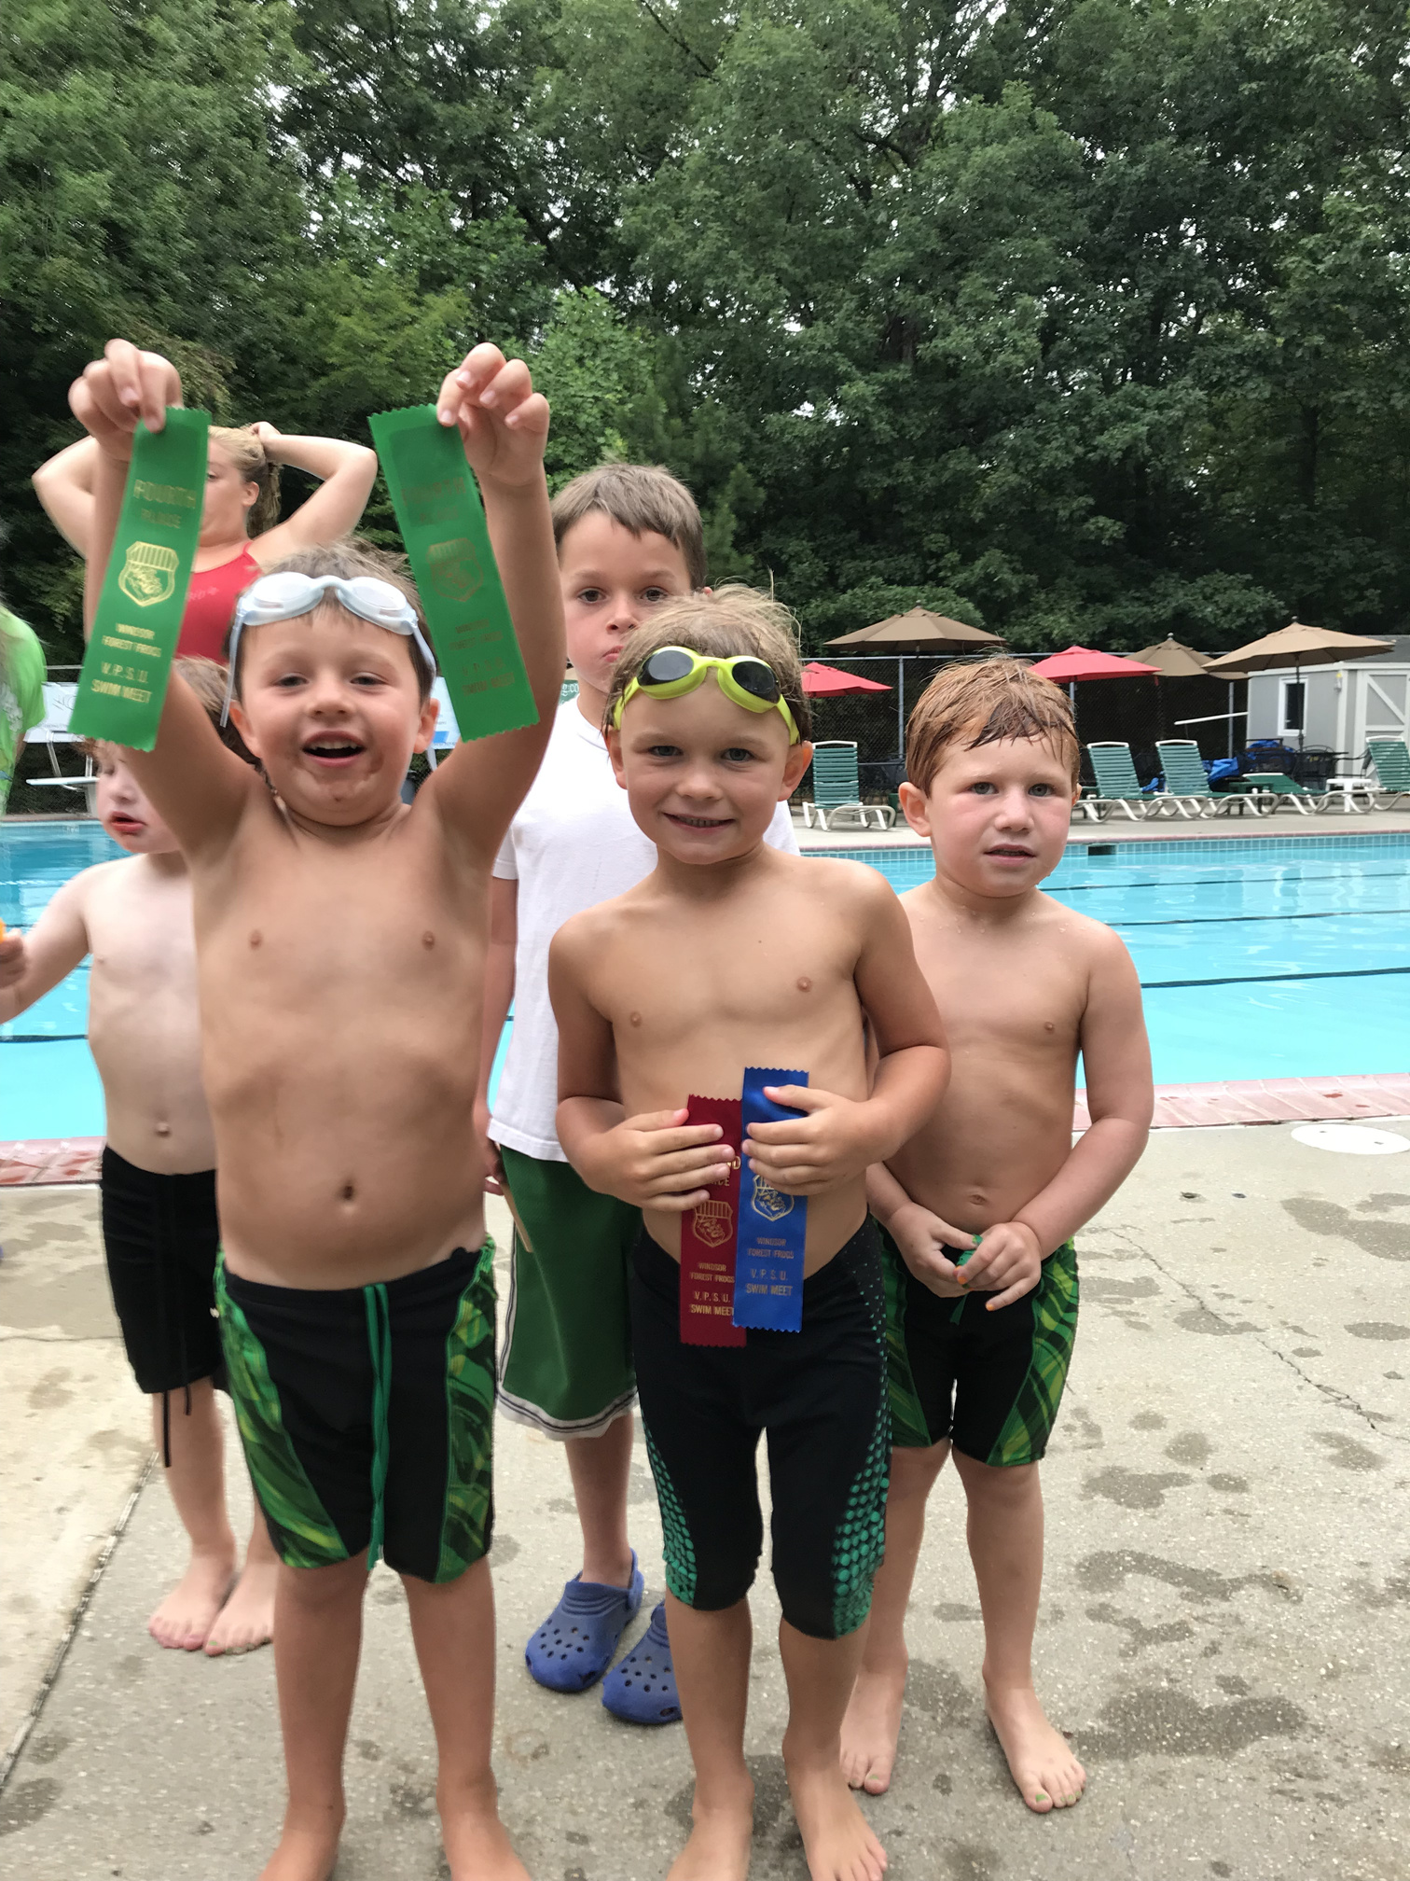
PRACTICE SCHEDULE
May 26th -June 12th
  8 and under: 5:00 -- 5:30
  9--12 year olds: 5:35 -- 6:30
  13 and over: 6:35 -- 7:30
June 15th-July 25th
  11 and over: 8:00-9:00
  9-10: 9:00-10:00
  8 & Under: 10:00-10:45
Tadpoles
July 16th -July 25th
  11:00-11:30
  11:30-12:00

Slide 6
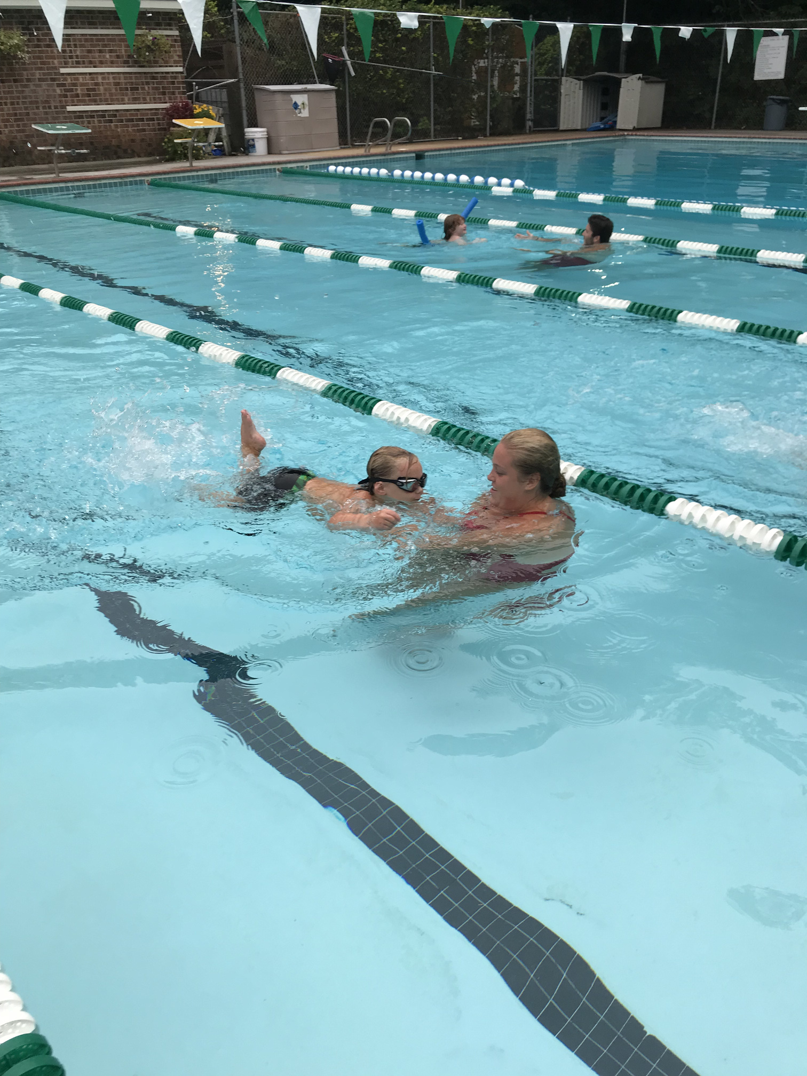

TADPOLES
  Tadpoles must be 3 or older and potty trained and ready to swim
  If your child isn’t ready a private lesson is a better choice.
  All tadpoles will be excepted to be able to be in the pool without the parent on deck. It is extremely hard to work with new swimmers who are nervous with parents standing by. All parents will be asked to wait on the outside of the pool deck until their session is over.
  Tadpoles will be split into two groups the first day of practice please plan on attending at 11:00 for this day only. Swimmers will be given their group to attend the next day. The first group will practice at 11:00 and the 2nd will be 11:30.
  Tadpole meet will be at the end of season August 3rd. Each swimmer will swim 2 events with or without kickboard if needed and/or a Frog swimmer to help. More information to come.
  Head Tadpole Coach is Amelia Butler and her Assistant Coach Anson Butler.
  Amelia will be your point of contact for tadpoles.
ameliaajb@icloud.com
(757) 951-8572

Slide 7

MEET SCHEDULE
EVERY MONDAY NIGHT!!!
June 15th Home. Kingswood Friendship
June 22nd Away Edgehill
June 30th Home. Powahtan Secondary
July 7th Home. West Point Dolphins
July 14th Away. Williamsburg Community
July 21st Away. Wellington
July 25th Summer Awards. Kingswood
August 1st VPSU CHAMPS. 757 Pool WISC
Home Meets
Away Meets
Swimmers will need to be at pool by 4:30 pm on Monday night for warmups.
Swimmers will need to be at the pool by 5:15 pm Monday night

Slide 8
SUMMER LEAGUE EXPECTATIONS
  Sportsmanship: Windsor Forest Frogs have always prided themselves on their fierce competitive nature and great sportmanship. We expect all of our coaches, athletes and parents to display the utmost respectful behavior while hosting and/or attending all swim meets as well as practices. Unsportsmanship like behavior will not be tolerated by coach, swimmer or parent!
  Communication: The coach will communicate through swimtopia. If there is a change to practice due to inclement weather the coach will send out alert via swimtopia. Other messages will be sent via email or left on the our swimtopia home page.

Slide 9
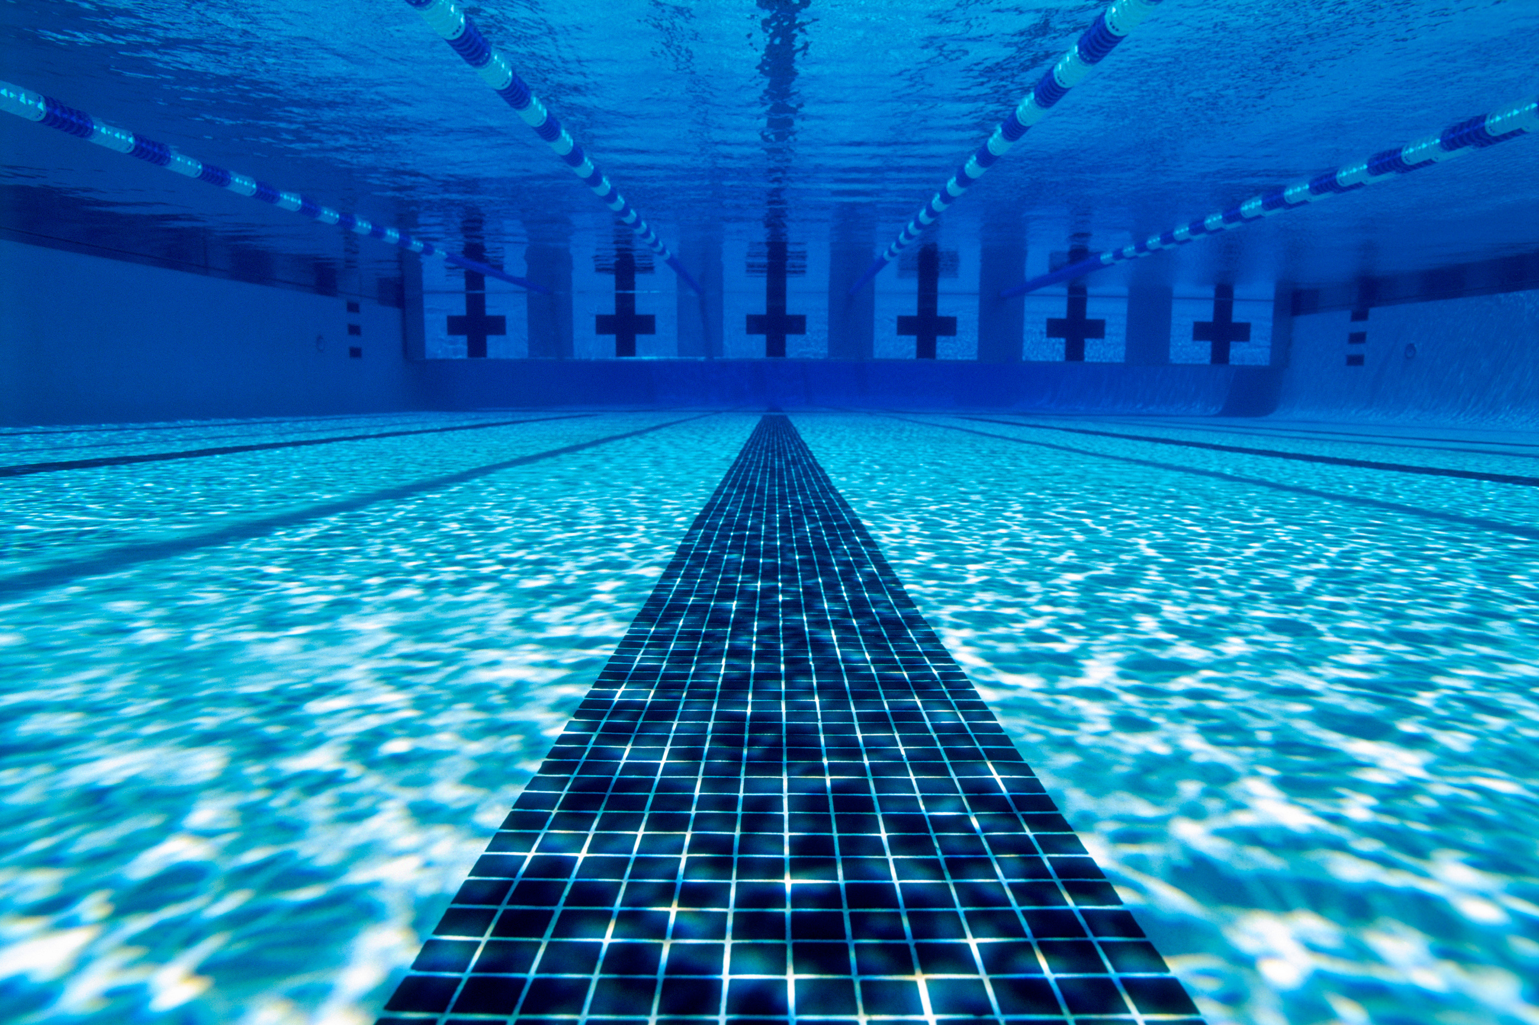
WINDSOR FOREST VOLUNTEER
RESPONSIBILITIES
  Volunteering is a must for our program to exist. We need all hands on deck to make sure our frogs have the best Summer!
  Please plan on having at least one parent volunteer for 1st or 2nd session of each home meet.
  Away meets require less volunteers but if your child is swimming plan on volunteering.
  Families must sign up for at least one set-up or one clean-up per home meet per season.
  All Job Descriptions are in Handbook
  Job Sign-Up here tonight or through Swimtopia or sign-up genius open now!

Slide 10
WINDSOR FOREST SPECIAL EVENTS & FUNDRAISING
Social Opportunities
  Ice Cream Social
  Pancake Breakfast
  End of Season Movie night...
  Beach Day
  Senior Night
Fundraising Opportunities
  Sponsorship signs
  Lap-a-thon
  4th of July 5k
  50/50 Raffle

Slide 11

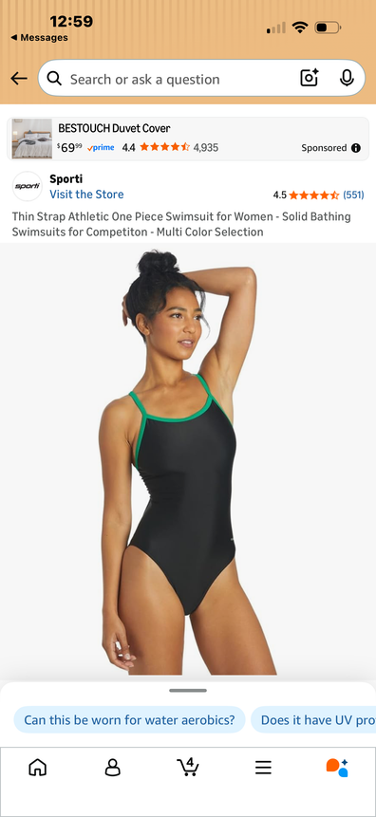
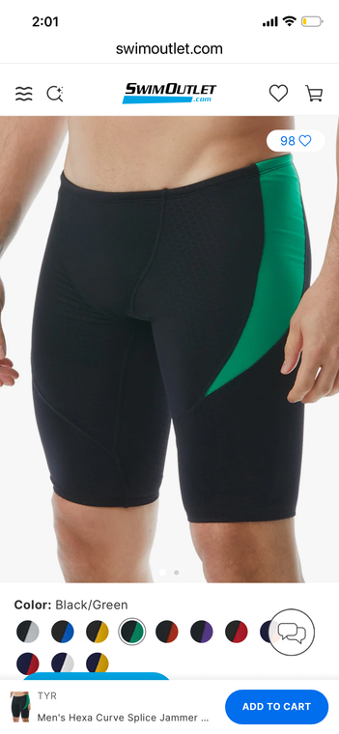
WINDSOR FOREST FROGS MERCHANDISE
  Other merchandise questions can be directed to Melissa McCartney
  Frogs team suit link can be found on our website as well as amazon.
  Caps will be provided to every swimmer!

Slide 12
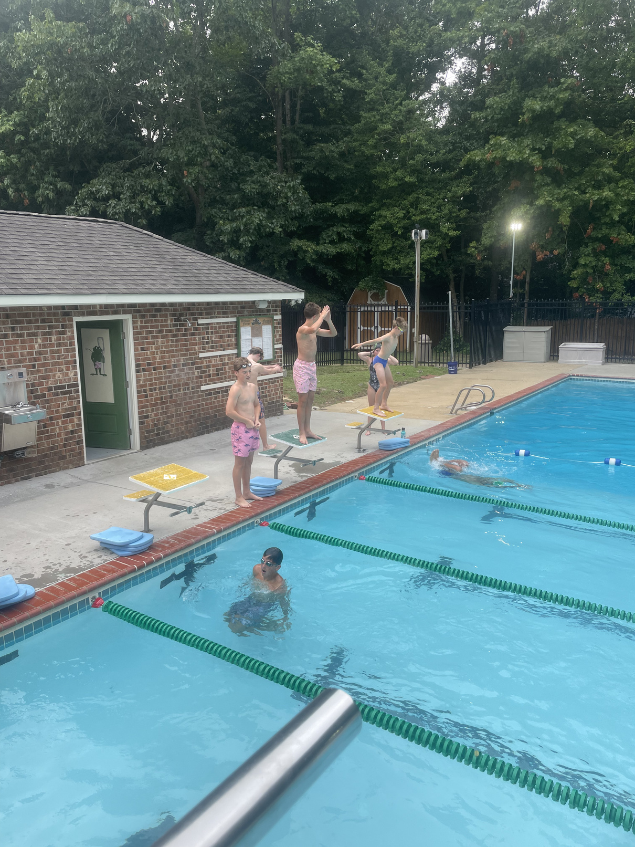
COST AND DUES
  Must be a pool member: If you need help we can point you to the Membership dues Chairperson.
  115.00 Per Swimmer
Not to exceed $460.00 per family
Must be able to swim the length of the pool
unassisted.
  100.0 Per Tadpole and 75.00 per additional tadpole
Must be 3 or older and potty trained
Child must not be afraid of the water and ready to
learn.
Child must be ok with parent not on deck and
watching from outside the fence.

Slide 13
WINDSOR FOREST SWIMTOPIA
SWIM TEAM WEBSITE
  All communication concerning swim team comes and goes through our team website.
Windsor Forest Swimtopia
  Available on PC or App for phones – enter your swimmer in meets, sign up for volunteer jobs (delete??), track your swimmer's times and race placements.
  •Declaring if you will attend the meets will need to be done from a computer not on the website.

Slide 14

WINDSOR FOREST
VOLUNTEERS NEEDED HOME & AWAY
Home: Away:
  Stroke and Turn -2. Stroke and Turn-2
  Ribbons-3 Ribbons-2
  Concessions-5
  Sweep Judge-2 Sweep Judge-2
  Runner-2 Scorer-1
  Clerk of Course-2 Clerk of course-1
  Timers-12 Timers- 8-10
The Windsor Forest Handbook will provide descriptions of the following volunteer positions. Prior to the swim team season starting there will be training sessions provide for Stroke and Turn as well as Timers. These sessions I believe will be available in person and online. Check the VPSU website for further information.

Slide 15
WHAT DO WE DO NEXT?
  Join HOA
  Register here tonight or on Windsor Forest Swimtopia
  Swim suit information: Swimoutlet is a great place to order, more information to follow.
  Caps will be provided for new swimmers.
  Contact wffrogsrock@gmail.com or www.windsorforestswimtopia.com

Slide 16
THANK
YOU

