Slide 1
CAK Swim
Information Meeting 2024-2025
THE
BEST
IS
YET
TO
COME

Slide 2
MISSION
CAK Athletics exists to reach students through sports and teach them how to be young men and women who LOVE others.
VISION
To create and sustain an uncommon culture that attracts students to participate in a transformational athletic experience.

Slide 3
LOVE IS THE STANDARD
L = LEAD COURAGEOUSLY
O = OTHERS FIRST
V = VICTORY MINDSET
E = EMPATHY & EXCELLENCE

Slide 4
All required paperwork must be turned in online prior to the swimmer entering the water:
Physical Form
Consent for Athlete Participation & Medical Care
Concussion Form
Cardiac Arrest Form

Slide 5
Practice
TBD
Allen Jones Aquatic Center or Student Aquatic Center
Monday-Thursday
Prioritizing Practice
Other sports, practices, commitments
Academic Requirements

Slide 6
Meet Your Coaches & Parent Representatives

Slide 7
Bailey Manifold (Head Coach)
(865)320-5900
baileymanifold1@gmail.com
Text me anytime, please give me at least 24 hours to respond to texts and emails. Call after 5PM

Slide 8
Thomas Horne (Technique Coach)
(865)850-1550
trhorne33@gmail.com

Slide 9
Leah Berry (HS Parent Representative)
In need of assistant this year to prepare for 2025-2026 season

Slide 10
RAISE YOUR HAND IF YOU ARE AN OFFICIAL.

Slide 11
Meets
Webb 11/3
  SAC
Bearden & CCS October 11/24
  Allan Jones Aquatic Center
  12/1 Grace Christian Academy & Alcoa High
    SAC
Ray Bussard Invitational December 21st?
  Allan Jones Aquatic Center
KISL & KMSSL Championship Meet January 24-26
  Allan Jones Aquatic Center
Last Chance Meet 1/27
  Allan Jones Aquatic Center
TISCA State Meet 2025, February 7-8, 2025
  Allan Jones Aquatic Center
4-5 meets beginning in November- end of January
Meet dates, times and locations will be finalized September 22nd on SwimTopia
Two meets are required to go to state.
One parent must volunteer at LEAST TWO meets!

Slide 12
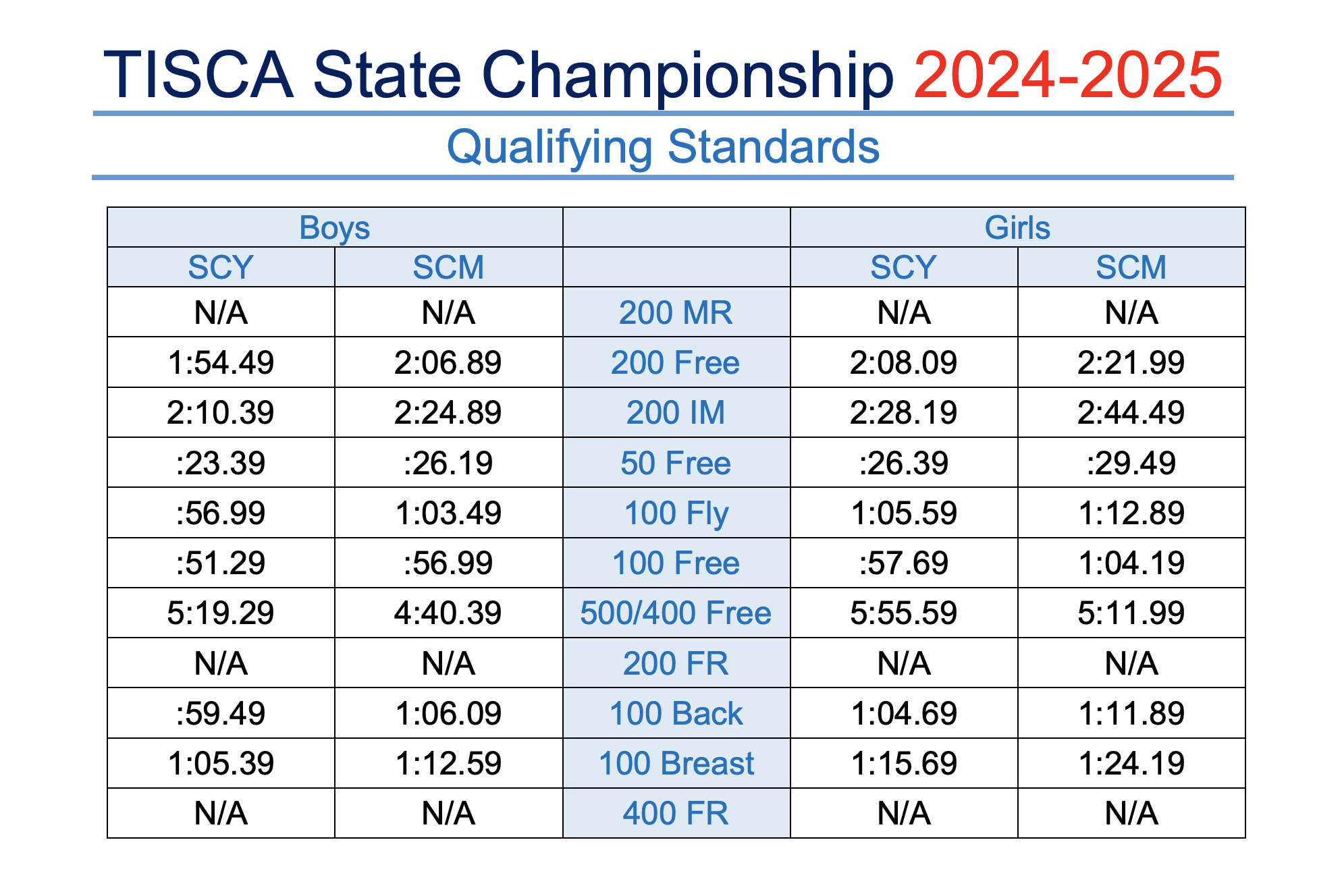

Slide 13
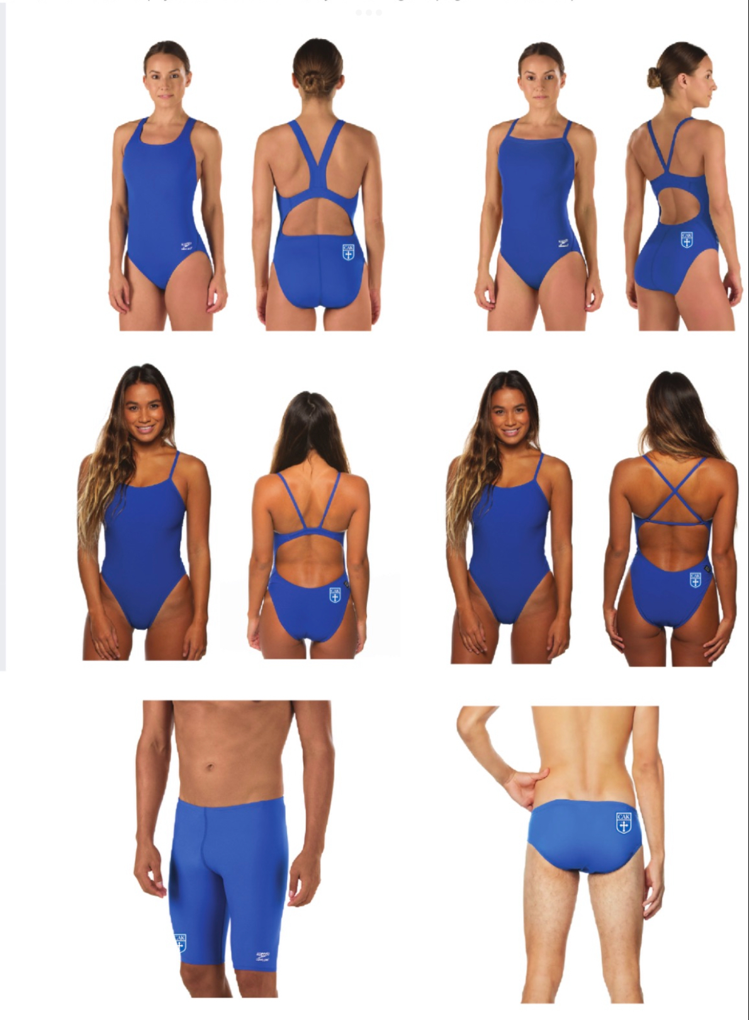
Suits and Gear

Slide 14
Gear
Nike SS Dri Fit (Men’s sizes)- $18.50 (Required for every member)
Nike Crew Neck Sweatshirt - $39.25
Fleece ¼ Zip: $29.99
Nike Joggers (Mens sizes) -$39.75
Team Caps: One included in $50 team fee, any other $10
If you need or want a CAK gear bag, they will be passed out at the first practice and must be returned at the end of the season
All gear and team fees will be billed through your school account and orders will go through the Google form.
Gear orders are due Oct. 20thh

Slide 15
Parent Involvement
Volunteers to host:
  Christmas Party
  Team “spaghetti dinner” meals prior to KISL Championships and State Meet
End of the Season Banquet coordinator
Service Project

